Slide 1
Tableau Metadata -Automation
Getting information about a Tableau workbook is a cumbersome process.
It requires a lot of manual effort even to identify the DB objects, columns and calculations used in a particular workbook.
This information is really helpful for documentation purposes and can help us to do our impact analysis without manual effort.
This would also help us understand the workbook better if we are planning to migrate to other tools (like PowerBI, Looker etc) to understand the data model and also the calculations involved.
This would ease out a lot of work while doing data analysis and preparing mapping document for any workbook.

Slide 2
Approach
Tableau workbook, under the hood, is just an XML file.
For each of the parameters that we are looking for, we will be having information in their respective TAGS.
We need to parse the XML tags and extract the information needed and dump it into an excel with the workbook name.
We can specify what all things we need and additional flags for easy & quick understanding.

Slide 3
Approach.. Next step
Initially, we can start small using one single workbook.
We can extend this later to pull reports from a specific server/site/project and then download the file, place it in a folder, parse the XML and store the result in one single excel.
We can create a summary view that gives us the all objects used and their frequency. This can help us in optimization.
Getting the column and object info can help us make the tableau workbooks leaner if there are orphan data sources.

Slide 4
Cases to be covered
To make sure this utility woks, we would have to test all the possible use cases that we have encountered and make it is effective for all the workbooks.
Cases:
Test with Live and Extract Connections.
Test with Joins -> a. with tables/views
b. with customsql for each object
Test with Relationships -> a. with tables/views
b. with customsql for each object
Test Initial SQL cases
Get info of Live and Extract data filters
If it’s a custom sql, parse that info into an excel structure
If it’s a .twbx file extract and get .twb file and then parse.
Test with multiple datasources.
Test with multiple connections.
Test Unions
Test with published data sources – If it’s a .tds or .tdsx file, then download that file first and later parse the XML.
Get Live or Extract info
Get info on the fields if they are hidden or not.

Slide 5
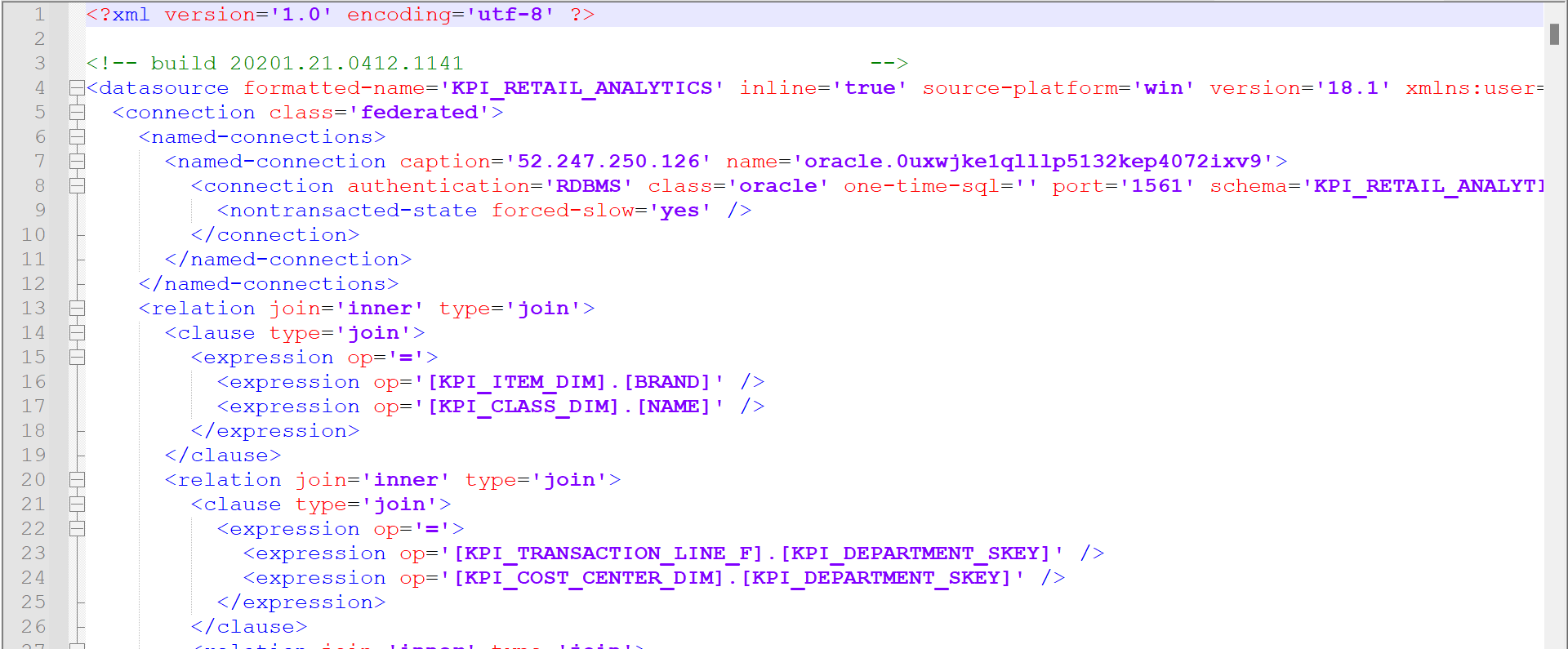

Slide 6
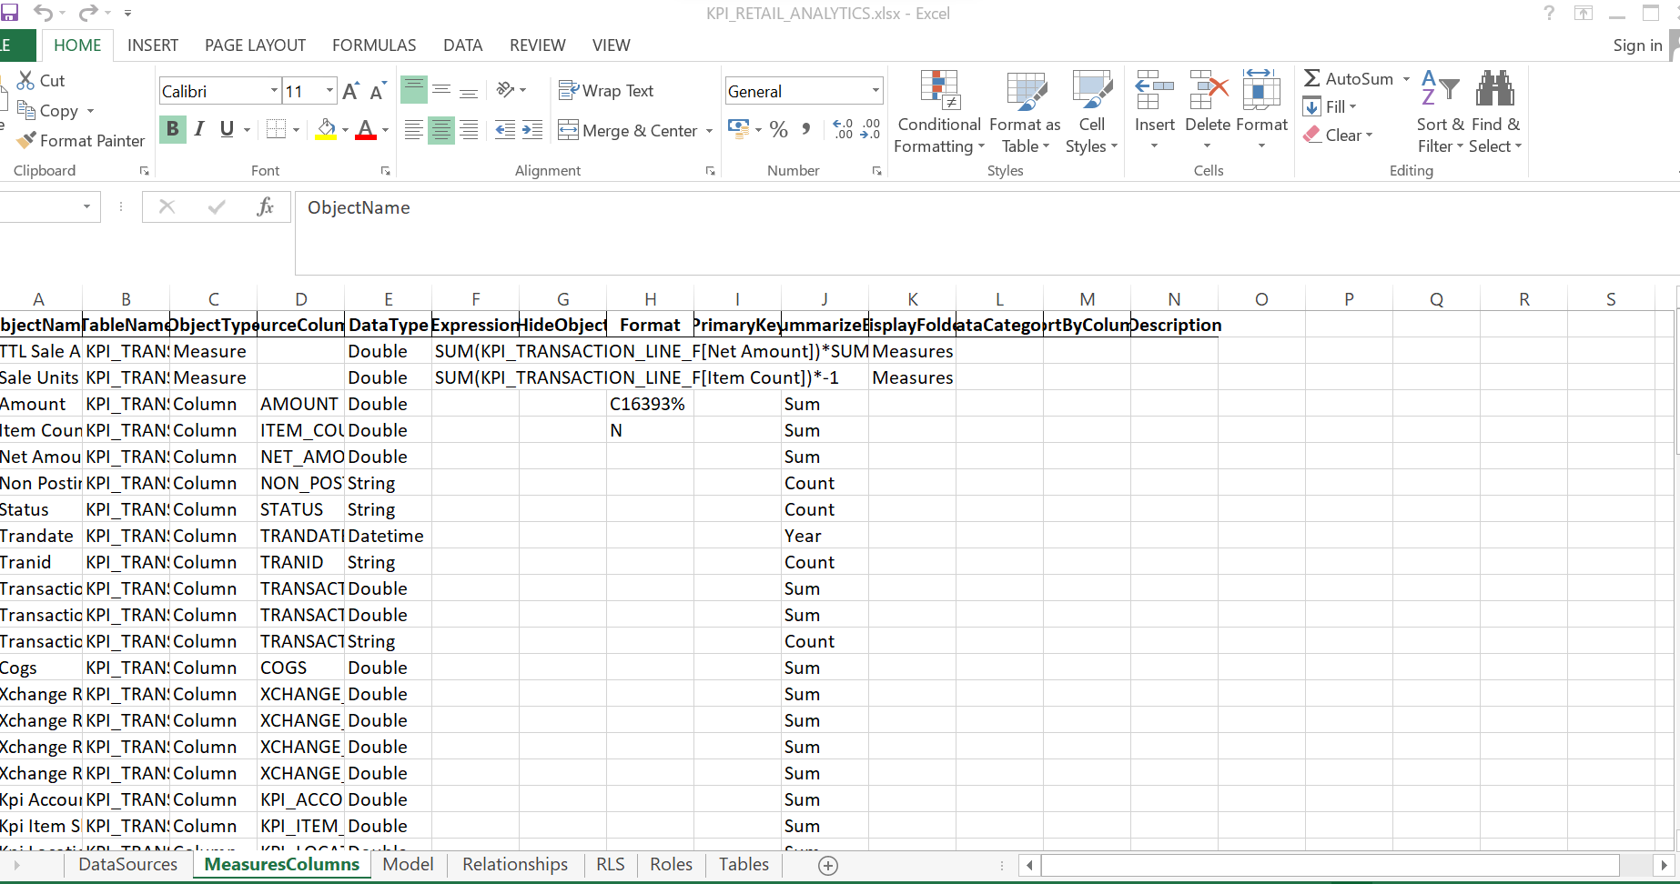
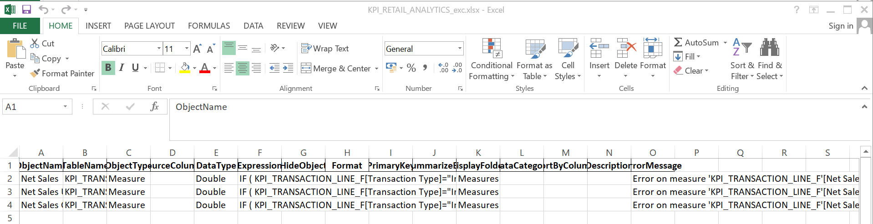

Slide 7
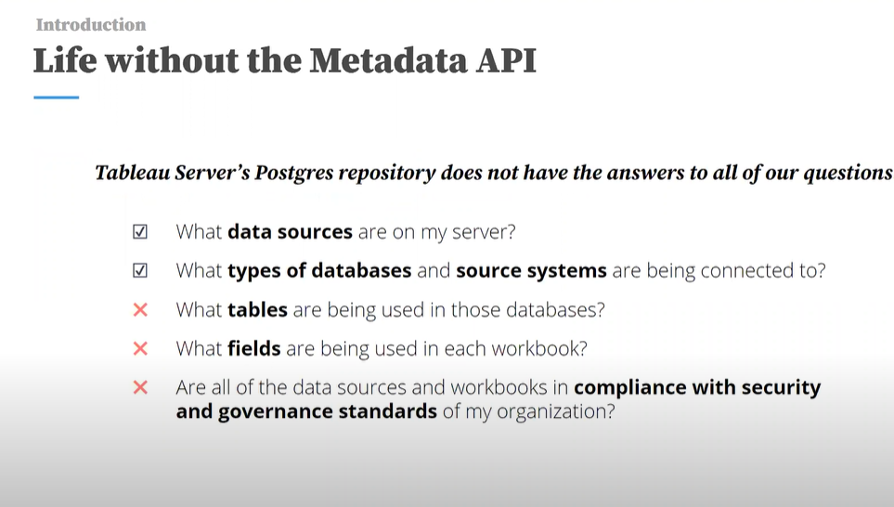

Slide 8
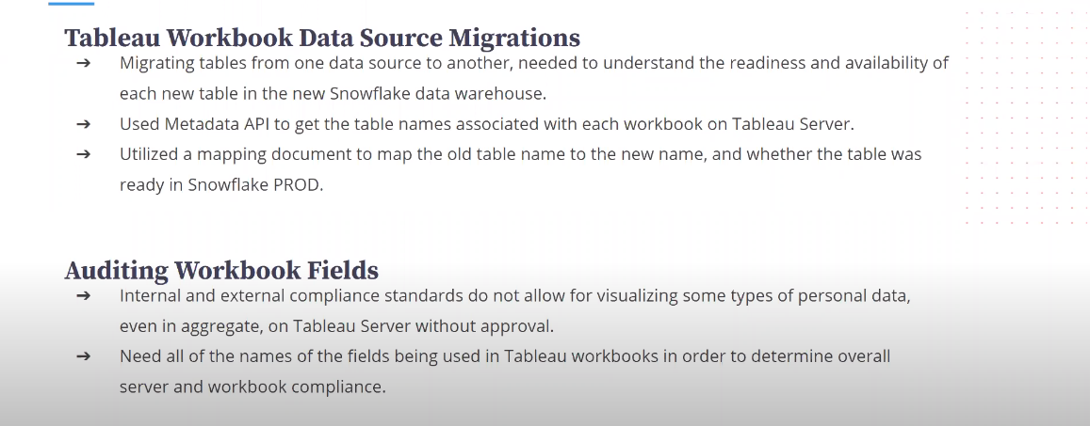

Slide 9
THANKS

